Slide 1
Collaborators: ML Theory textbook

Slide 2
Assignment 3
Your name: Bojun Yang
Your GTID: byang301

Slide 3
Visualization

Slide 4
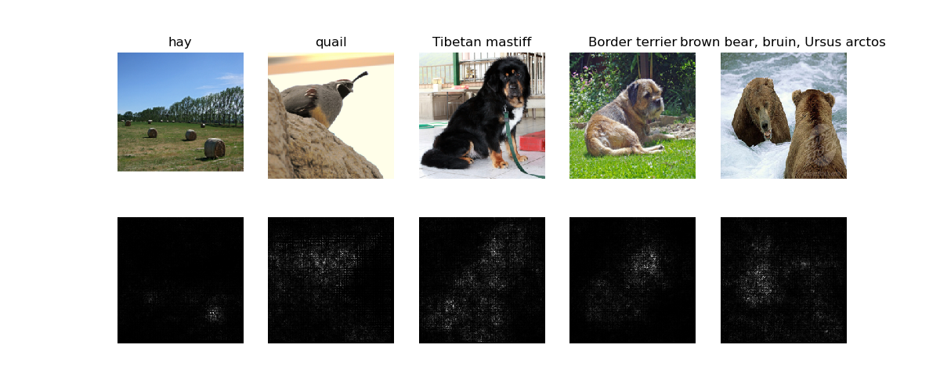
Saliency Map (1 point)
Include your saliency map here

Slide 5
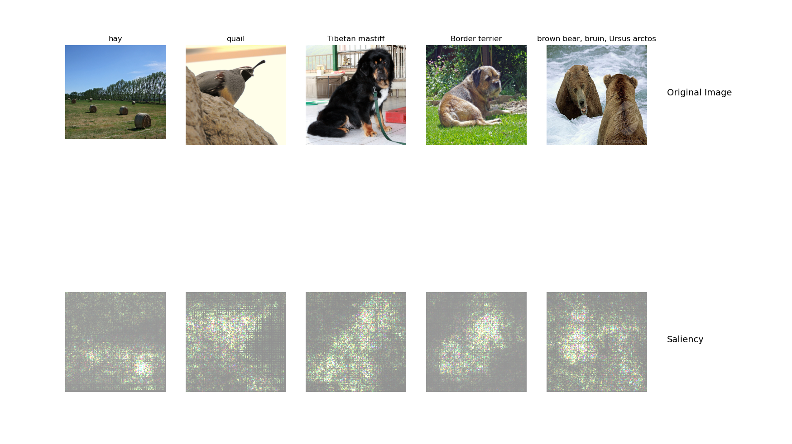
Saliency Map Captum (1 point)
Include your saliency map from Captum here

Slide 6
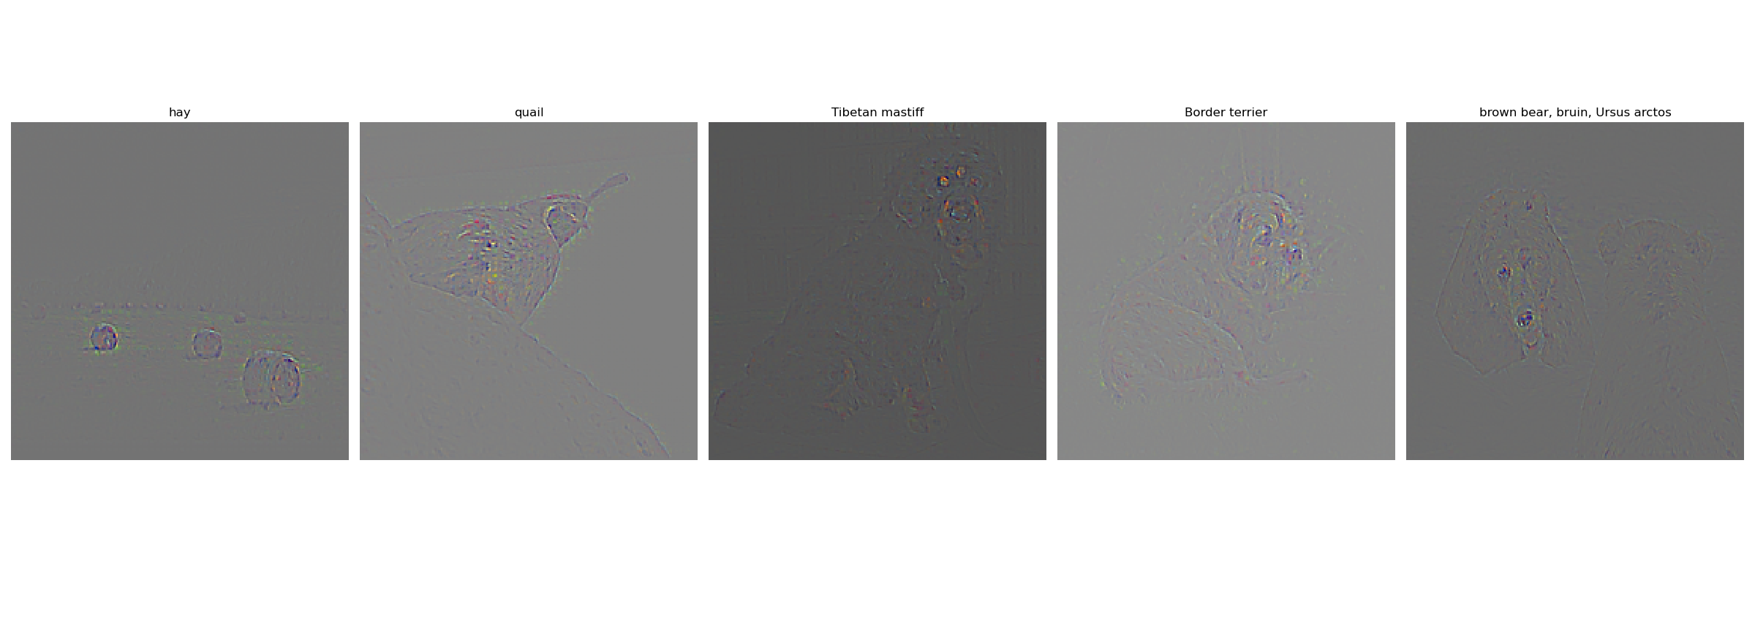
Guided Backprop (1 point)
Include your visualization of Guided Backprop here

Slide 7
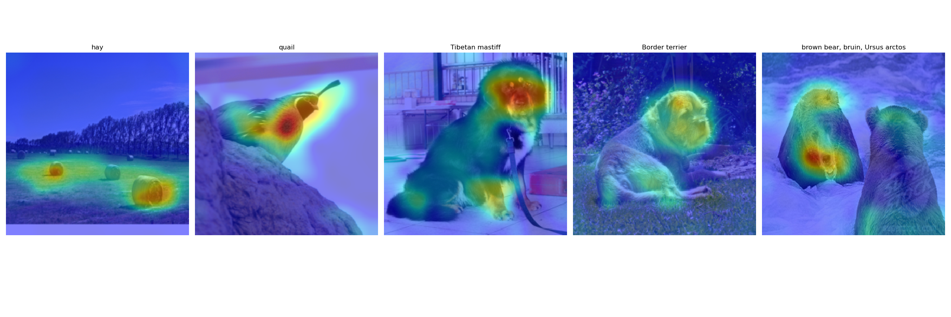
GradCam (1 point)
Include your visualization of GradCam here

Slide 8
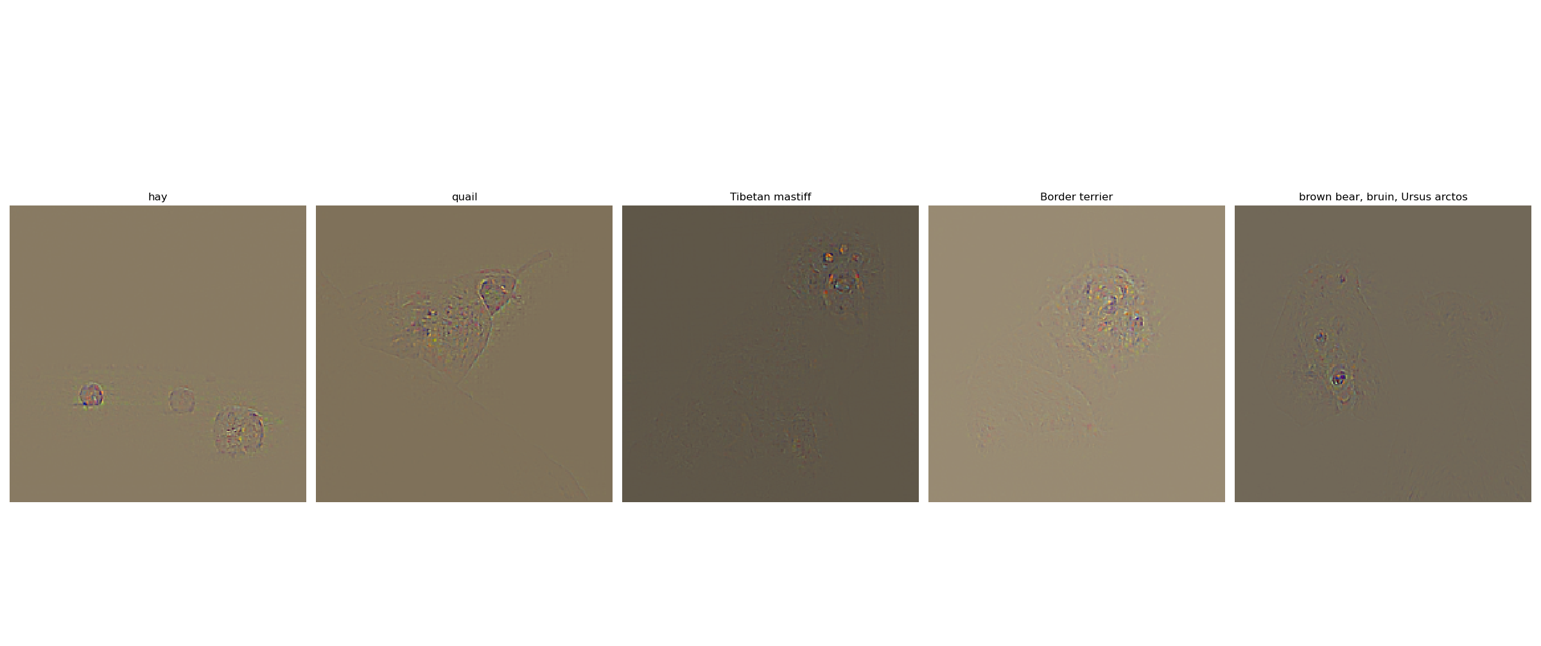
Guided GradCam (1 point)
Include your visualization of Guided GradCam here

Slide 9
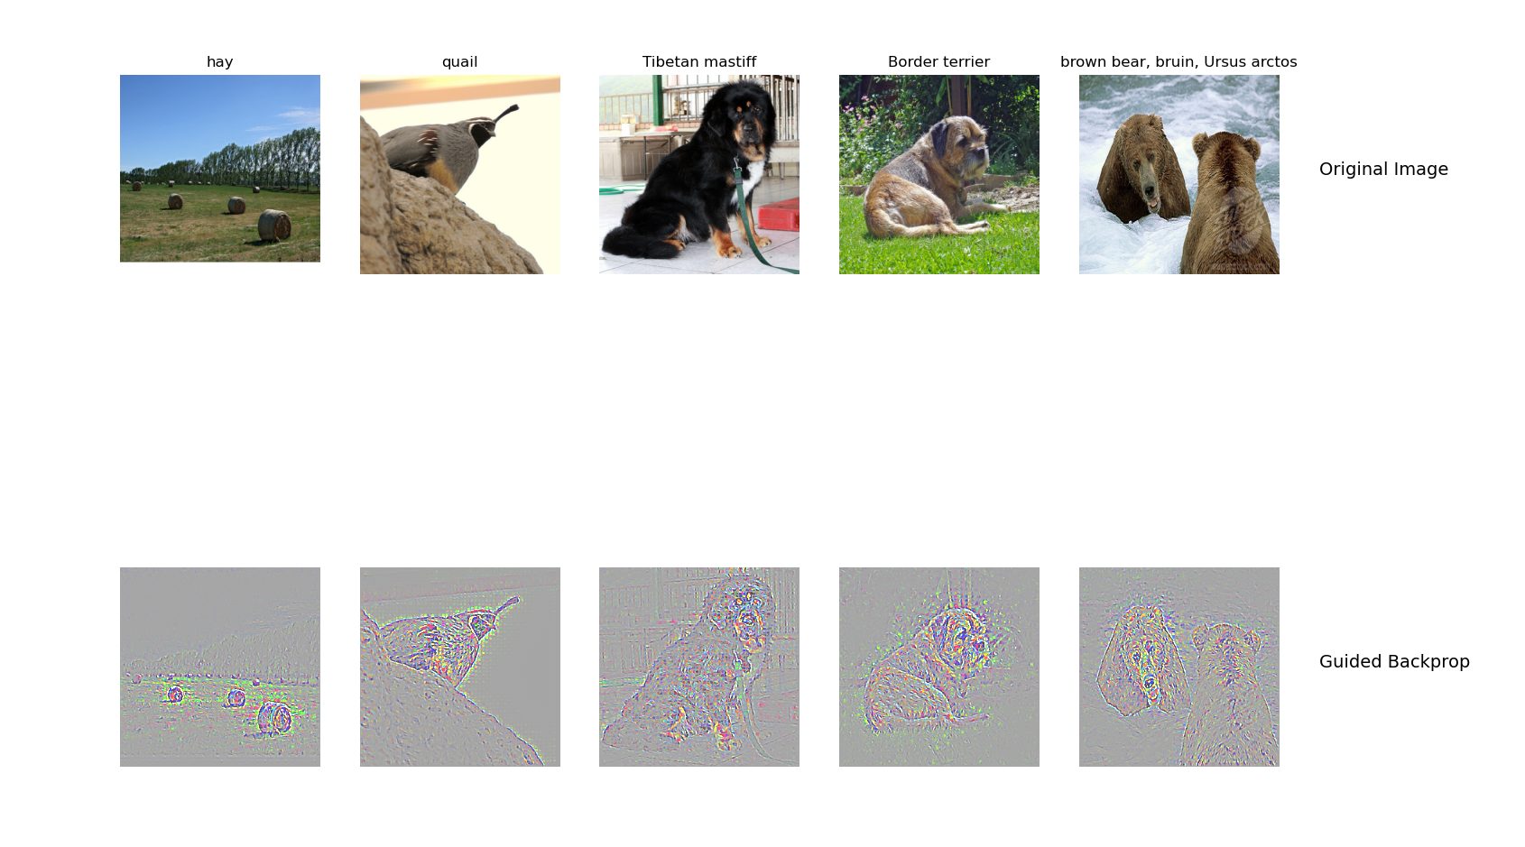
Guided Backprop + GradCam (Captum) (1 point)
Include your visualization of Guided Backprop and Guided Gradcam from Captum here

Slide 10
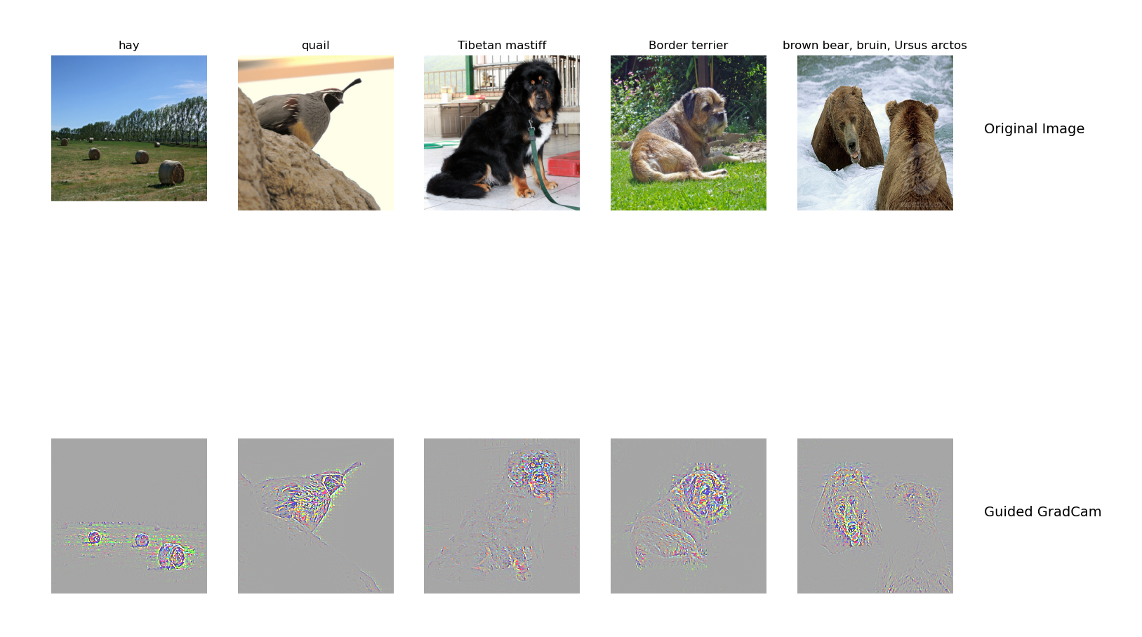

Slide 11
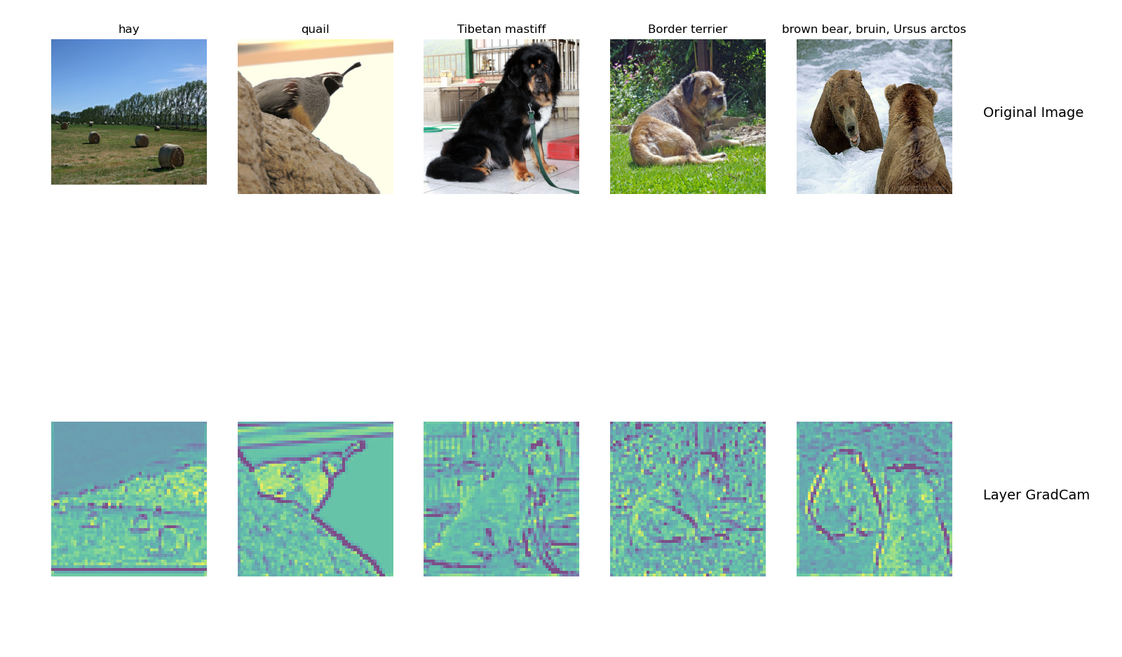
Layers and neurons using Captum (1 point)
Visualization of layers and neurons using Captum here(Note: You are only expected to submit the visualization results from the given layer in the instruction (i.e. layer = model.features[3]))

Slide 12
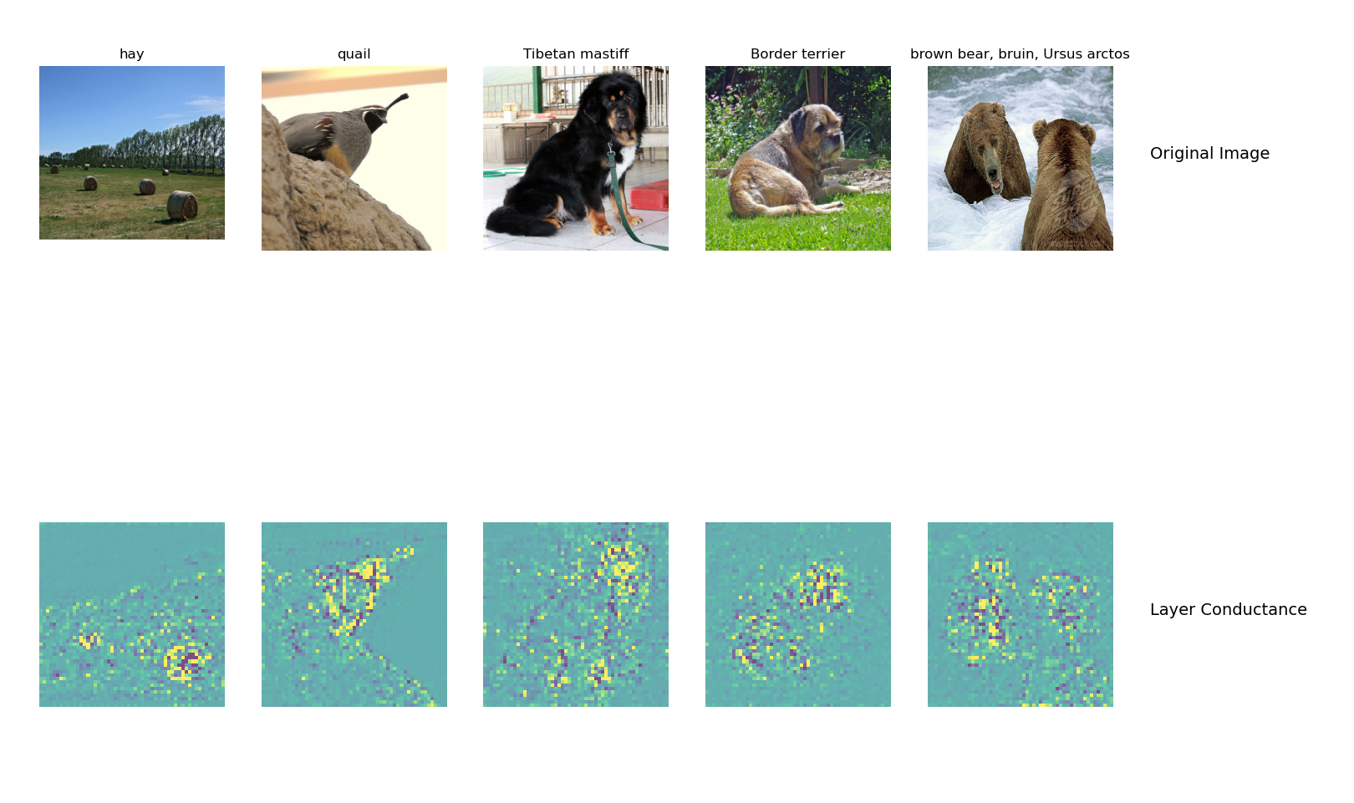

Slide 13
What do saliency map and Gradcam tell you? (1 point)
Saliency map tells use the degree to which each pixel in the image affects the classification score of that image. Brighter pixels correspond to higher effect on the classification.
Gradcam tells use where the network is looking when it is classifying an input image. It highlights the important regions within the input image for classification.

Slide 14
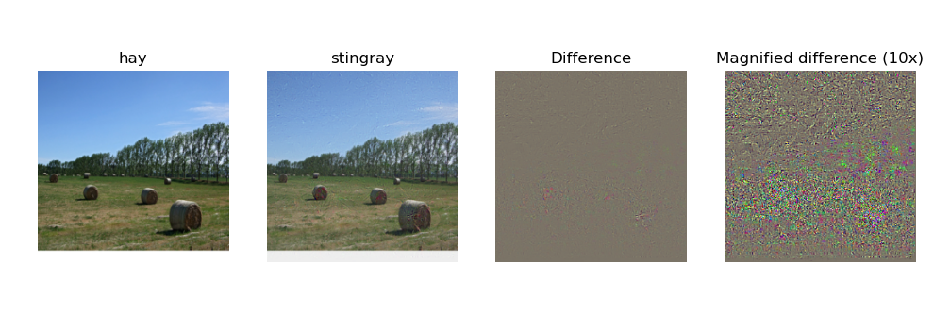
Fooling Image (1 point)
Include the fooling image here

Slide 15
Fooling Image Insights (1 point)
What insights do you get from fooling images:
Even though the fooling image would fool the network into classifying it as a stingray, it still looks the same as hay to the human. This tells us that networks can be easily tricked since it only takes very small differences in the pixels to confuse a nn.

Slide 16
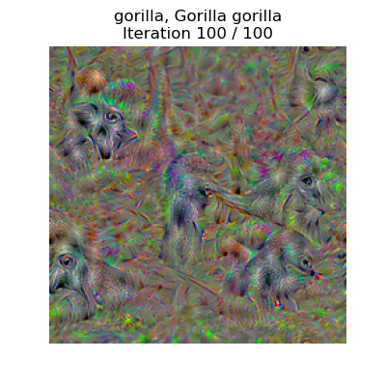
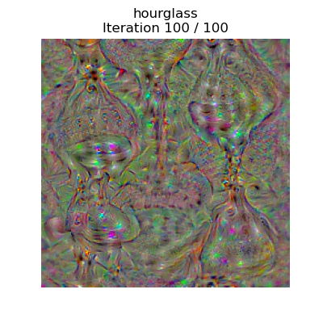
Class Visualization (3 points)

Slide 17
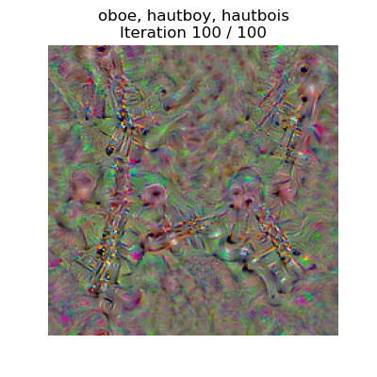
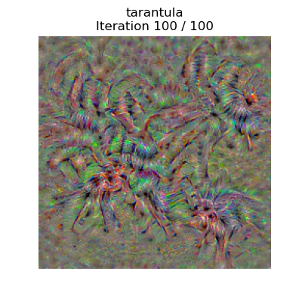

Slide 18
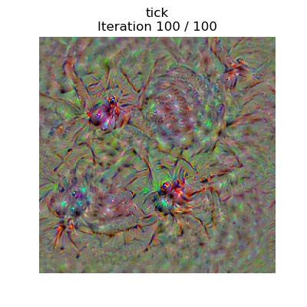
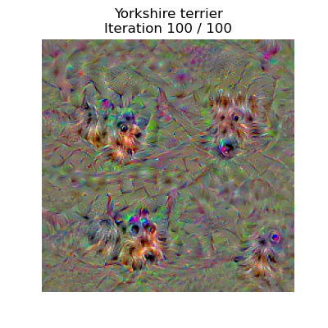

Slide 19
Style Transfer

Slide 20
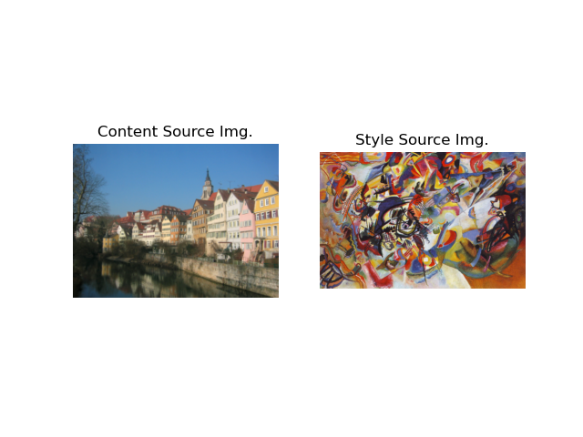
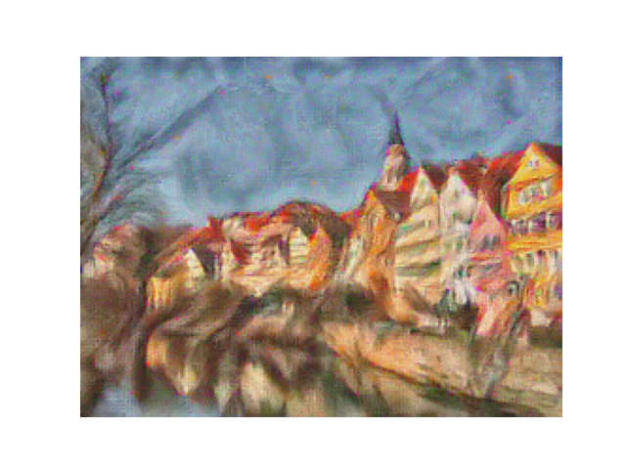
Composition VII + Tubingen (1 point)

Slide 21
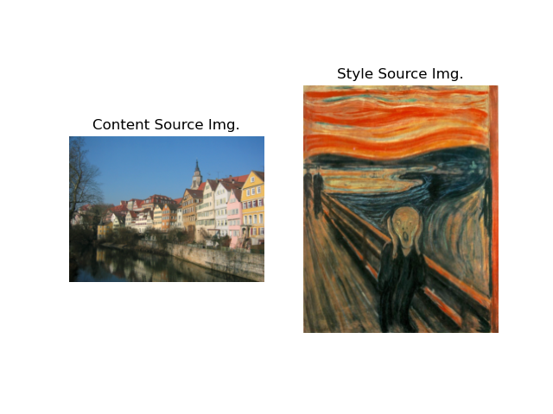
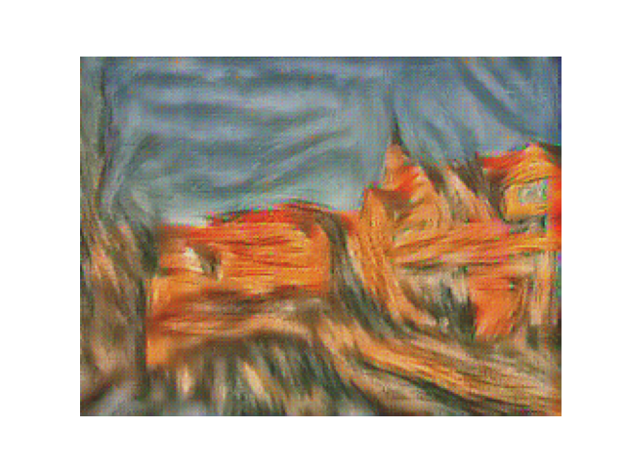
Scream + Tubingen (1 point)

Slide 22
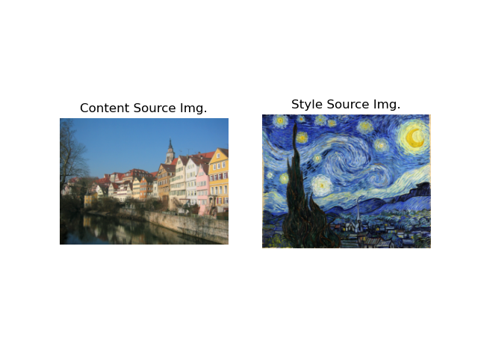
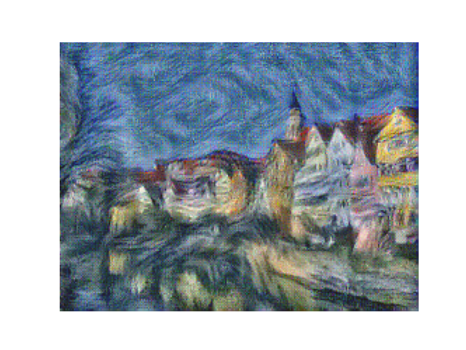
Starry Night + Tubingen (1 point)

Slide 23
Be sure to append the jupyter notebook i.e. $root/test_style_transfer.ipynb for testing sections of the style transfer implementation to this report.

